Slide 1
Topic 2: Direct Link Network
Week
3
Direct-link networks
datagram
Link layer protocol
Adapter
Adapter
frame
frame
Sender
Receiver

Slide 2
Topic’s objectives
To find out the answers to:
1 – What are common types of line encodings?
2 – What are common types of framing protocols?

Slide 3
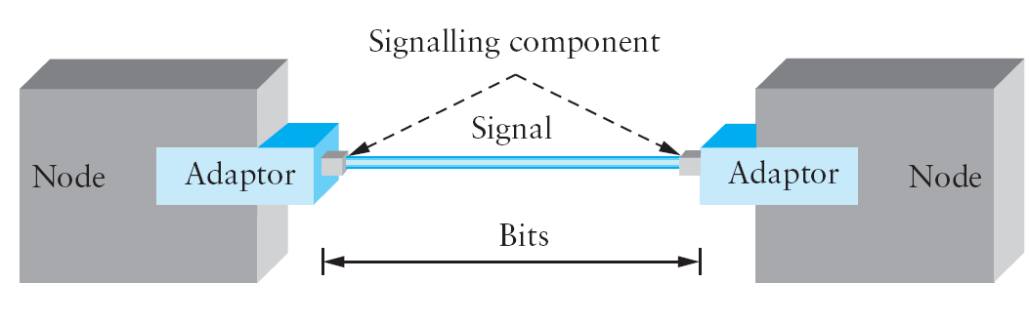
Encoding
Notes:
The first step in turning nodes and links into usable building blocks is to understand how to connect them in such a way that bits can be transmitted from one node to the other. Since it is actually signals that propagate over physical links. The binary data that the source node wants to send, therefore, has to be encoded into the signals that the links are able to carry, and the signal has to be decoded back into the corresponding binary data at the receiving node.
We ignore the details of modulation and assume we are working with two discrete signals: high and low. In practice, these signals might correspond to two different voltages on a copper-based link, or two different power levels on an optical link.
As we have said, most of the functions discussed during our lectures on Data-link protocols are performed by a network adaptor—a piece of hardware that connects a node to a link. The network adaptor contains a signaling component that actually encodes bits into signals at the sending node and decodes signals into bits at the receiving node. Thus, as illustrated in the figure shown above, signals travel over a link between two signaling components, and bits flow between network adaptors.

Slide 4
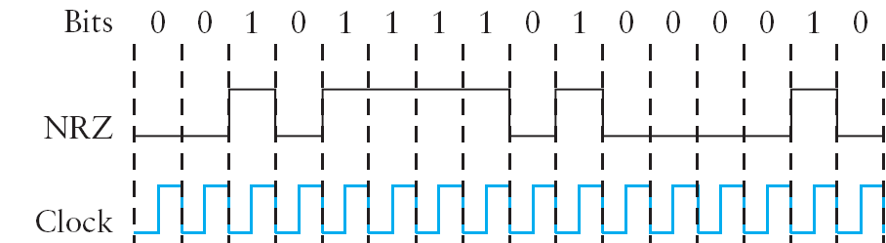
NRZ (Non-return to zero)
Problems of baseline-wander and clock drift
Notes:
Let’s return to the problem of encoding bits onto signals. The obvious thing to do is to map the data value 1 onto the high signal and the data value 0 onto the low signal. This is exactly the mapping used by an encoding scheme called, cryptically enough, non-return to zero (NRZ). For example, the figure above schematically depicts the NRZ-encoded signal (bottom) that corresponds to the transmission of a particular sequence of bits (top).
The problem with NRZ is that a sequence of several consecutive 1s means that the signal stays high on the link for an extended period of time, and similarly, several consecutive 0s means that the signal stays low for a long time. There are two fundamental problems caused by long strings of 1s or 0s. The first is that it leads to a situation known as baseline wander. Specifically, the receiver keeps an average of the signal it has seen so far, and then uses this average to distinguish between low and high signals. Whenever the signal is significantly lower than this average, the receiver concludes that it has just seen a 0, and likewise, a signal that is significantly higher than the average is interpreted to be a 1. The problem, of course, is that too many consecutive 1s or 0s cause this average to change, making it more difficult to detect a significant change in the signal.
The second problem follows in the next slide:

Slide 5
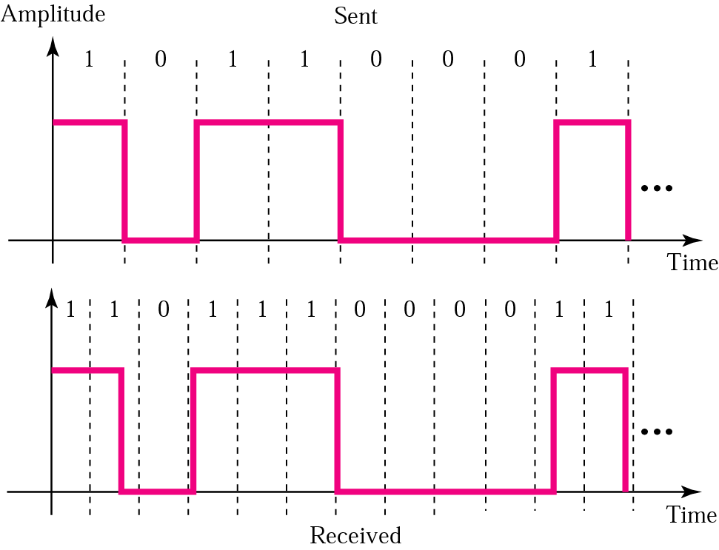
Problems due to “Clock drift”
Notes:
In digital transmission, Bit slip is the loss of a bit or bits, caused by clock drift – variations in the respective clock rates of the transmitting and receiving devices.
The second problem is that frequent transitions from high to low and vice versa are necessary to enable clock recovery. Intuitively, the clock recovery problem is that both the encoding and the decoding processes are driven by a clock—every clock cycle the sender transmits a bit and the receiver recovers a bit. The sender’s and the receiver’s clocks have to be precisely synchronized in order for the receiver to recover the same bits the sender transmits. If the receiver’s clock is even slightly faster or slower than the sender’s clock, then it does not correctly decode the signal. You could imagine sending the clock to the receiver over a separate wire, but this is typically avoided because it makes the cost of cabling twice as high. So instead, the receiver derives the clock from the
received signal—the clock recovery process. Whenever the signal changes, such as on a transition from 1 to 0 or from 0 to 1, then the receiver knows it is at a clock cycle boundary, and it can resynchronize itself. However, a long period of time without such a transition leads to clock drift. Thus, clock recovery depends on having lots of transitions in the signal, no matter what data is being sent.

Slide 6
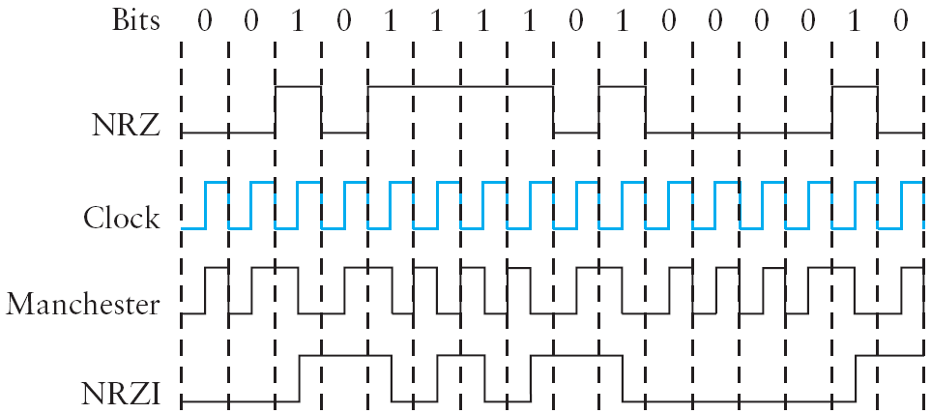
NRZ-I Encoding
Transition because next bit is a 1
Notes:
One approach that addresses the “clock drift” problem, called non-return to zero inverted (NRZI), has the sender make a transition from the current signal to encode a 1 and stay at the current signal to encode a 0. This solves the problem of consecutive 1s, but obviously does nothing for consecutive 0s.

Slide 7
Manchester Coding
Manchestor Encoding = NRZ XOR Clock
Transition for 0
(like a clock pulse)
Transition for 1
(inverse of a clock pulse)
Self Clocking Encoding
Notes:
An alternative, called Manchester encoding, does a more explicit job of merging the clock with the signal by transmitting the exclusive-OR of the NRZ-encoded data and the clock.

Slide 8
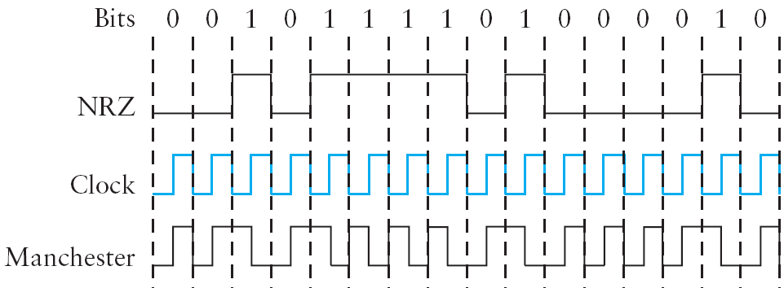
Manchester Coding
Notes:
An alternative, called Manchester encoding, does a more explicit job of merging the clock with the signal by transmitting the exclusive-OR of the NRZ-encoded data and the clock.
(Think of the local clock as an internal signal that alternates from low to high; a low/high pair is considered one clock cycle.) The Manchester encoding is also illustrated in Figure 2.7. Observe that the Manchester encoding results in 0 being encoded as a low-to-high transition and 1 being encoded as a high-to-low transition. Because both 0s and 1s result in a transition to the signal, the clock can be effectively recovered at the receiver.
Problem: The problem with the Manchester encoding scheme is that it doubles the rate at which signal transitions are made on the link, which means that the receiver has half the time to detect each pulse of the signal. The rate at which the signal changes is called the link’s baud rate. In the case of the Manchester encoding, the bit rate is half the baud rate, so the encoding is considered only 50% efficient. Keep in mind that if the receiver had been able to keep up with the faster baud rate required by the Manchester encoding in Figure 2.7, then both NRZ and NRZI could have been able to transmit twice as many bits in the same time period.
(There is also a variant of the Manchester encoding, called differential Manchester, in which a 1 is encoded with the first half of the signal equal to the last half of the previous bit’s signal and a 0 is encoded with the first half of the signal opposite to the last half of the previous bit’s signal.)

Slide 9
4B/5B Coding
Code every 4 bits of actual data -> 5 bit code ensuring:
Not more than one leading 0
Not more than two trailing 0s
In the transmitted bit stream, no more than 3 0s
Resulting 5-bit code transmitted using NRZI
which already takes care of series of 1s
Notes:
A final encoding that we consider, called 4B/5B, attempts to address the inefficiency of the Manchester encoding without suffering from the problem of having extended durations of high or low signals. The idea of 4B/5B is to insert extra bits into the bit stream so as to break up long sequences of 0s or 1s. Specifically, every 4 bits of actual data are encoded in a 5-bit code that is then transmitted to the receiver; hence the name 4B/5B. The 5-bit codes are selected in such a way that each one has no more than one leading 0 and no more than two trailing 0s. Thus, when sent back-to-back, no pair of 5-bit codes results in more than three consecutive 0s being transmitted. The resulting 5-bit codes are then transmitted using the NRZI encoding, which explains why the code is only concerned about consecutive 0s—NRZI already solves the problem of consecutive 1s. Note that the 4B/5B encoding results in 80% efficiency.

Slide 10
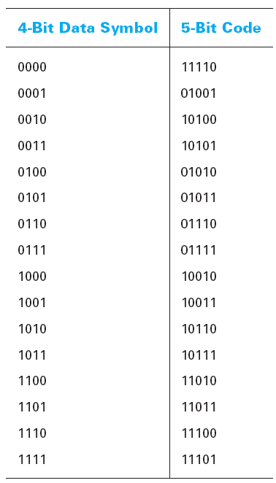
4B/5B Coding
Notes:
The mapping of 4-bit data symbol to a 5 bit code is shown above.
As seen in the code above,
There is no more than one leading 0 in the resulting code
There is no more than two trailing 0s

Slide 11
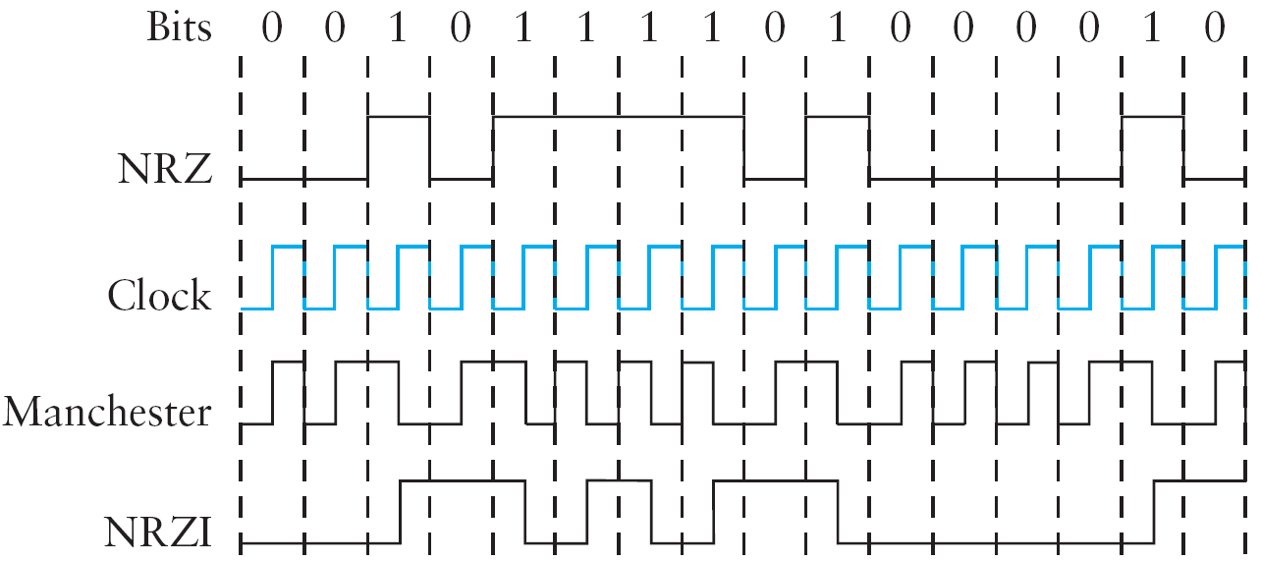
Exercise

Slide 12
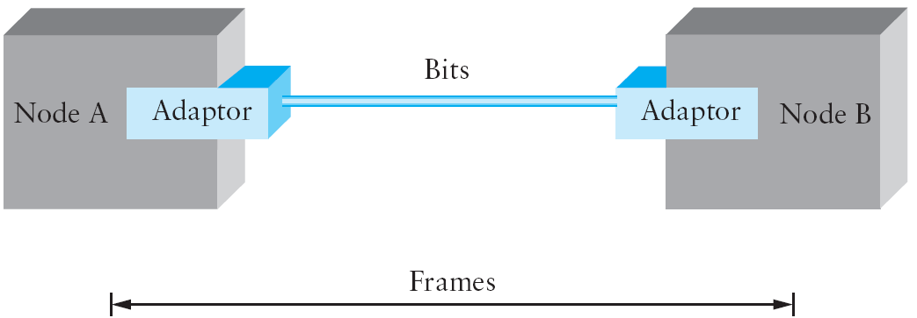
Framing
Synchronous and Asynchronous Transmission
Notes:
ASYNCHRONOUS VS. SYNCHRONOUS COMMUNICATION:
Asynchronous protocols treat each character in a bit stream independently. Synchronous protocols take the whole bit stream and chop it into characters of equal size.
Asynchronous protocols are employed mainly in modems. Due to its inherent slowness (stemming from the requirement of addition of start/ stop bits and extended spaces between frames), asynchronous communication is rapidly being replaced by synchronous communication.
Synchronous protocols:
The speed of synchronous transmission makes it a better choice over asynchronous transmission for LAN, MAN and WAN technology. Protocols governing synchronous transmission can be further divided into two classes: 1) character oriented protocols and 2) bit oriented protocols.
In this lecture, from here forth, we are only going to focus on synchronous communication and its two major types: 1) byte-oriented framing; 2) character-oriented framing.
What is Framing: Since we are focusing on packet-switched networks, which means that blocks of data (called frames at this level), not bit streams, are exchanged between nodes. It is the network adaptor that enables the nodes to exchange frames.
Central challenge: When node A wishes to transmit a frame to node B, it tells its adaptor to transmit a frame from the node’s memory. This results in a sequence of bits being sent over the link. The adaptor on node B then collects together the sequence of bits arriving on the link and deposits the corresponding frame in B’s memory. Recognizing exactly what set of bits constitutes a frame—that is, determining where the frame begins and ends—is the central challenge faced by the adaptor.
There are several ways to address the framing problem. We will discuss different protocols to illustrate the various points in the design space. Note that while we discuss framing in the context of point-to-point links, the problem is a fundamental one that must also be addressed in multiple-access networks like Ethernet and token rings.

Slide 13
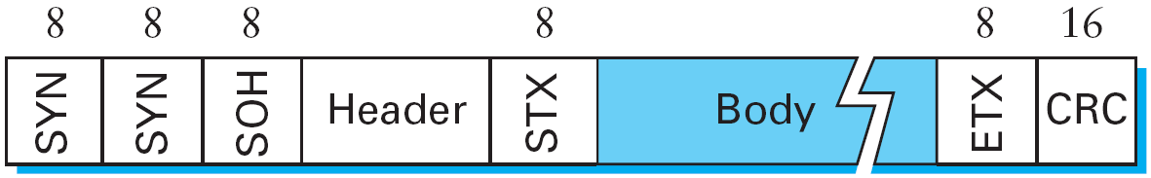
Byte-oriented Framing
a) Sentinel Approach
BISYNC (Binary Synchronous Communication) protocol
Special sentinel characters: STX and ETX
(indicate start and end of data portion of the frame)
Data-link-escape (DLE) character used if ETX in data
Notes:
One of the oldest approaches to framing—it has its roots in connecting terminals to mainframes—is to view each frame as a collection of bytes (characters) rather than a collection of bits. Such a byte-oriented approach is exemplified by the BISYNC (Binary Synchronous Communication) protocol developed by IBM in the late 1960s, and the DDCMP (Digital Data Communication Message Protocol) used in Digital Equipment Corporation’s DECNET.
Although similar in many respects, these two protocols are examples of two different framing techniques, the sentinel approach and the byte-counting approach.
In this slide, we will discuss the sentinel approach:
The BISYNC protocol illustrates the sentinel approach to framing; its frame format is depicted in the figure above.
The approach: The beginning of a frame is denoted by sending a special SYN (synchronization) character. The data portion of the frame is then contained between special sentinel characters: STX (start of text) and ETX (end of text). The SOH (start of header) field serves much the same purpose as the STX field.
The frame format also includes a field labeled CRC (cyclic redundancy check) that is used to detect transmission errors; various algorithms for error detection will be presented in the next lecture. Finally, the frame contains additional header fields that are used for, among other things, the link-level reliable delivery algorithm. Examples of these algorithms will be given in the next lecture.
Problem with this approach: The problem with the sentinel approach, of course, is that the ETX character might appear in the data portion of the frame. BISYNC overcomes this problem by “escaping” the ETX character by preceding it with a DLE (data-link-escape) character whenever it appears in the body of a frame; the DLE character is also escaped (by preceding it with an extra DLE) in the frame body.
Byte-oriented protocols are not as efficient as bit-oriented protocols and therefore are seldom used.

Slide 14
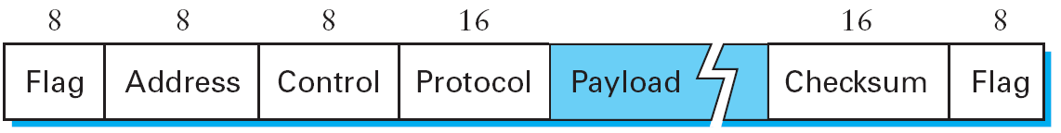
Byte-oriented Framing
a) Sentinel Approach
PPP (Point to Point Protocol)
Special STX character 01111110 used (in Flag field)
Several field sizes are negotiated rather than fixed
(through Link Control Protocol or LCP)
Notes:
Point to Point Protocol:
The more recent Point-to-Point Protocol (PPP), which is commonly run over dialup modem links, is similar to BISYNC in that it uses character stuffing. The format for a PPP frame is given in the figure above. The special start-of-text character, denoted as the
Flag field in Figure 2.10, is 01111110. The Address and Control fields usually contain default values, and so are uninteresting. The Protocol field is used for demultiplexing: It identifies the high-level protocol such as IP or IPX (an IP-like protocol developed
by Novell). The frame payload size can be negotiated, but it is 1500 bytes by default.
The Checksum field is either 2 (by default) or 4 bytes long. The PPP frame format is unusual in that several of the field sizes are negotiated rather than fixed. This negotiation is conducted by a protocol called LCP (Link Control Protocol). PPP and LCP work in tandem: LCP sends control messages encapsulated in PPP frames—such messages are denoted by an LCP identifier in the PPP Protocol field—and then turns around and changes PPP’s frame format based on the information contained in those control messages. LCP is also involved in establishing a link between two peers when both sides detect the carrier signal.

Slide 15
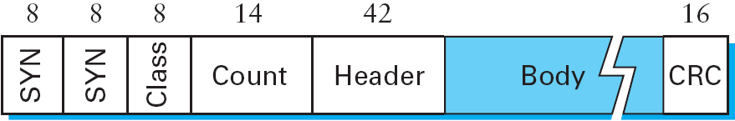
Byte-oriented Framing
b) Byte-counting approach
DDCMP (Digital Data Communications Message Protocol)
?
What if Count field is corrupted
Notes:
An alternative to detecting the end of a file with a sentinel value is to include the number of items in the file at the beginning of the file. The same is true in framing—the number of bytes contained in a frame can be included as a field in the frame header. DECNET’s DDCMP protocol uses this approach, as illustrated in the figure above. In this example, the COUNT field specifies how many bytes are contained in the frame’s body.
Problem with this approach: One danger with this approach is that a transmission error could corrupt the COUNT field, in which case the end of the frame would not be correctly detected. (A similar problem exists with the sentinel based approach if the ETX field becomes corrupted.) Should this happen, the receiver will accumulate as many bytes as the bad COUNT field indicates and then use the error detection field to determine that the frame is bad. This is sometimes called a framing error. The receiver will then wait until it sees the next SYN character to start collecting the bytes that make up the next frame. It is therefore possible that a framing error will cause back-to-back frames to be incorrectly received.
About the DDCMP Protocol:
Digital Data Communications Message Protocol (DDCMP) is a communications protocol devised by Digital Equipment Corporation in 1974 to allow communication over point-to-point network links for the company's DECnet Phase I network protocol. The protocol uses full or half duplex synchronous and asynchronous links and allowed errors introduced in transmission to be detected and corrected. It was retained and extended for later versions of the DECnet protocol.

Slide 16
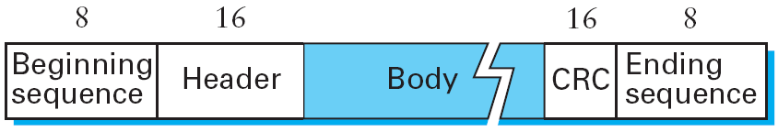
Bit-oriented Framing
HDLC (High-level Data-Link Control)
Special bit sequence 01111110 used as
Beginning Sequence and Ending Sequence
(Thus HDLC uses a sentinel approach)
Notes:
Bit-oriented protocol is a communications protocol that sees the transmitted data as an opaque stream of bits with no semantics, or meaning. Control codes are defined in terms of bit sequences instead of characters. Bit oriented protocol can transfer data frames regardless of frame contents.
Unlike byte-oriented protocols (BISYNC, PPP and DDCMP), a bit-oriented protocol is not concerned with byte boundaries—it simply views the frame as a collection of bits. These bits might come from some character set, such as ASCII, they might be pixel values in an image, or they could be instructions and operands from an executable file. The Synchronous Data Link Control (SDLC) protocol developed by IBM is an example of a bit-oriented protocol; SDLC was later standardized by the ISO as the High-Level Data Link Control (HDLC) protocol. For the purpose of our discussion, we will use HDLC as an example of a bit-oriented framing protocol.
HDLC denotes both the beginning and the end of a frame with the distinguished bit sequence 01111110. This sequence is also transmitted during any times
that the link is idle so that the sender and receiver can keep their clocks synchronized. In this way, both protocols essentially use the sentinel approach. Because this sequence might appear anywhere in the body of the frame—in fact, the bits 01111110 might cross byte boundaries—bit-oriented protocols use the analog of the DLE character, a technique known as bit stuffing.
Bit stuffing in the HDLC protocol works as follows. On the sending side, any time five consecutive 1s have been transmitted from the body of the message (i.e.,
excluding when the sender is trying to transmit the distinguished 01111110 sequence), the sender inserts a 0 before transmitting the next bit. On the receiving side, should five consecutive 1s arrive, the receiver makes its decision based on the next bit it sees (i.e., the bit following the five 1s). If the next bit is a 0, it must have been stuffed, and so the receiver removes it. If the next bit is a 1, then one of two things is true: Either this is the end-of-frame marker or an error has been introduced into the bit stream. By looking at the next bit, the receiver can distinguish between these two cases: If it sees a 0 (i.e., the last eight bits it has looked at are 01111110), then it is the end-offrame marker; if it sees a 1 (i.e., the last eight bits it has looked at are 01111111), then there must have been an error and the whole frame is discarded. In the latter case, the receiver has to wait for the next 01111110 before it can start receiving again, and as a consequence, there is the potential that the receiver will fail to receive two consecutive frames. Obviously, there are still ways that framing errors can go undetected, such as when an entire spurious end-of-frame pattern is generated by errors, but these failures are relatively unlikely.

Slide 17
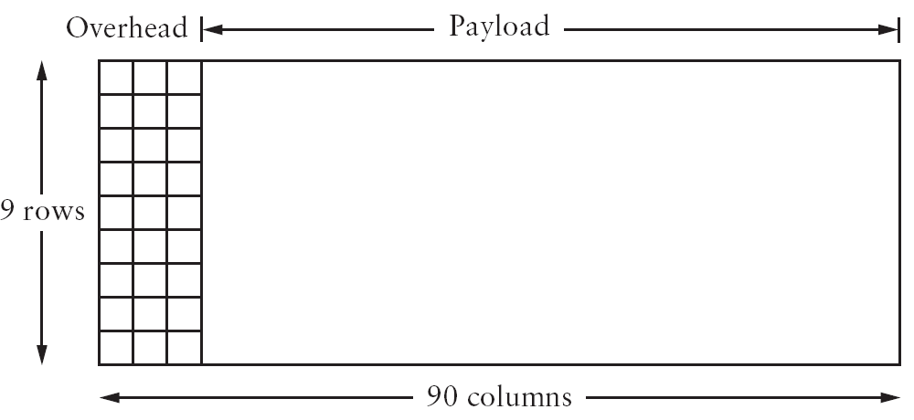
Clock-based Framing - SONET
The first two bytes of a frame
contain a special bit pattern
used to identify start of frame
Fixed sized frames; does not use bit stuffing
Notes:
A third approach to framing is exemplified by the Synchronous Optical Network (SONET) standard. For lack of a widely accepted generic term, we refer to this approach simply as clock-based framing. SONET is that it is the dominant standard for long-distance transmission of data over optical networks. SONET addresses both the framing problem and the encoding problem. It also addresses a problem that is very important for phone companies—the multiplexing of several low-speed links onto one high-speed link.
SONET uses constant sized frames; this is done by avoiding a scheme that uses bit stuffing. So the question to ask is, How does the receiver know where each frame starts and ends? We consider this question for the lowest-speed SONET link, which is known as STS-1 and runs at 51.84 Mbps.
An STS-1 frame is shown in the figure above. It is arranged as nine rows of 90 bytes each, and the first 3 bytes of each row are overhead, with the rest being available for data that is being transmitted over the link. The first 2 bytes of the frame contain a special bit pattern, and it is these bytes that enable the receiver to determine where the frame starts.
However, since bit stuffing is not used, there is no reason why this pattern will not occasionally turn up in the payload portion of the frame. To guard against this, the receiver looks for the special bit pattern consistently, hoping to see it appearing once every 810 bytes, since each frame is 9 × 90 = 810 bytes long. When the special pattern turns up in the right place enough times, the receiver concludes that it is in sync and can then interpret the frame correctly.
SONET is a very complex protocol and due to its functionality, it’s very complex; therefore, by necessity, we’ll only be discussing some high level details of SONET.
SONET also encodes the data using NRZ (but we will not be discussing it any further in this class) since we’re dealing with the framing aspect of SONET.

Slide 18
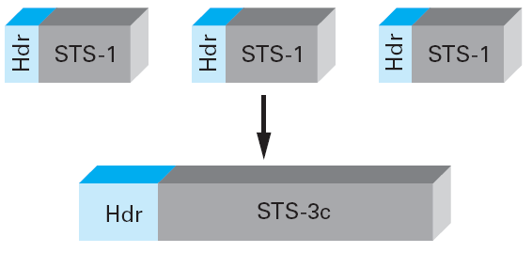
SONET - Multiplexing
Notes:
STS-1: 51.84 Mbps
STS-3c (used in SONET) = STM-1 (used in SDH) = 155.52.

Slide 19

References
Sections [P&D]
2.2 and 2.3:
Direct Link
Networks

Slide 20

?
?
Questions/ Confusions?
?
Use the discussion forum at:
http://compnets.ning.com/
Credits/ Acknowledgement at:
http://sites.google.com/site/cse320site/

